Slide 1
CAE Final Project
Structural analysis of motor part of self-made car
and its development
2023.11.27
Notes:
Hello, we are team (). And I’d like to present about our this week’s progress of final project.

Slide 2
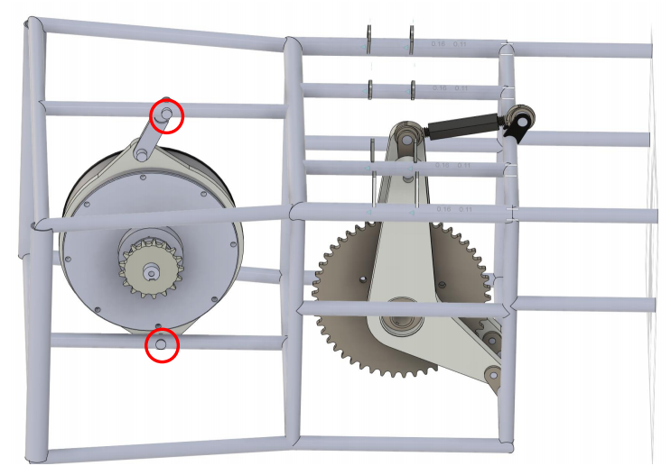
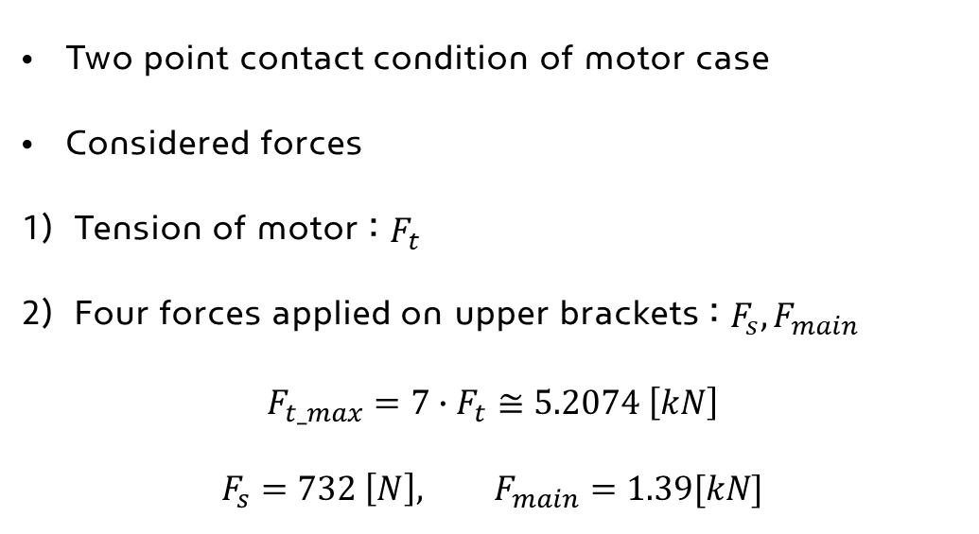
▣ Problem analysis
Two point contact condition of motor case
Considered forces
Tension of motor : $F_{t}$
Four forces applied on upper brackets : $F_{s}, F_{main}$
$$F_{t_max}=7∙F_{t}≅5.2074 \left[kN\right]$$
$$F_{s}=732 \left[N\right], F_{main}=1.39[kN]$$
Problem model
[Problem model : 2 point contact]
Chain loosening problem
Rear frame displacement problem
Notes:
First, the shape of the model that has a problem in actual operation is as follows. You can see that the motor case is connected with the main frame with two point contacts.
And the calculated tension that we have to consider is about 700 N. And generally, considering some coefficients, the maximum tension we got is about 5 kN.
And the main problem of this structure was chain loosening and um,, some cases that seem to be a material yield in some frames of the rear part.
So we planned to make some developments to solve those problems by getting proper analysis of this model.

Slide 3
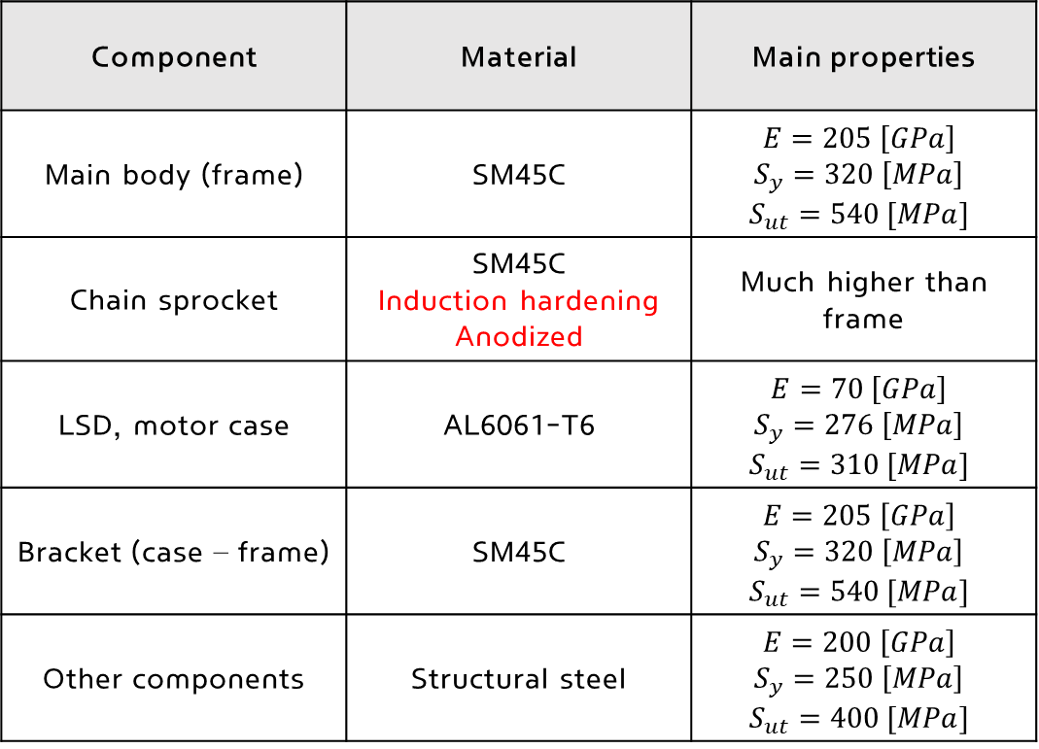
▣ Problem analysis
Material of component
Table 1. Material of each component
Component | Material | Main properties
Main body (frame) | SM45C | $$E=205 \left[GPa\right]$$ $$S_{y}=320 \left[MPa\right]$$ $$S_{ut}=540 [MPa]$$
Chain sprocket | SM45C Induction hardening Anodized | Much higher than frame
LSD, motor case | AL6061-T6 | $$E=70 \left[GPa\right]$$ $$S_{y}=276 \left[MPa\right]$$ $$S_{ut}=310 [MPa]$$
Bracket (case – frame) | SM45C | $$E=205 \left[GPa\right]$$ $$S_{y}=320 \left[MPa\right]$$ $$S_{ut}=540 [MPa]$$
Other components | Structural steel | $$E=200 \left[GPa\right]$$ $$S_{y}=250 \left[MPa\right]$$ $$S_{ut}=400 [MPa]$$
[Problem model : 2 point contact]
Notes:
The materials used in actual vehicles are as follows.
For the main frame, SM45C material was used.
And up, for chain sprockets subject to large tension, reinforced SM45C was used.
In addition, aluminum T6 was used for the motor case and LSD.
And some parts those were not necessary for the analysis were set with steel and the analysis was performed.

Slide 4
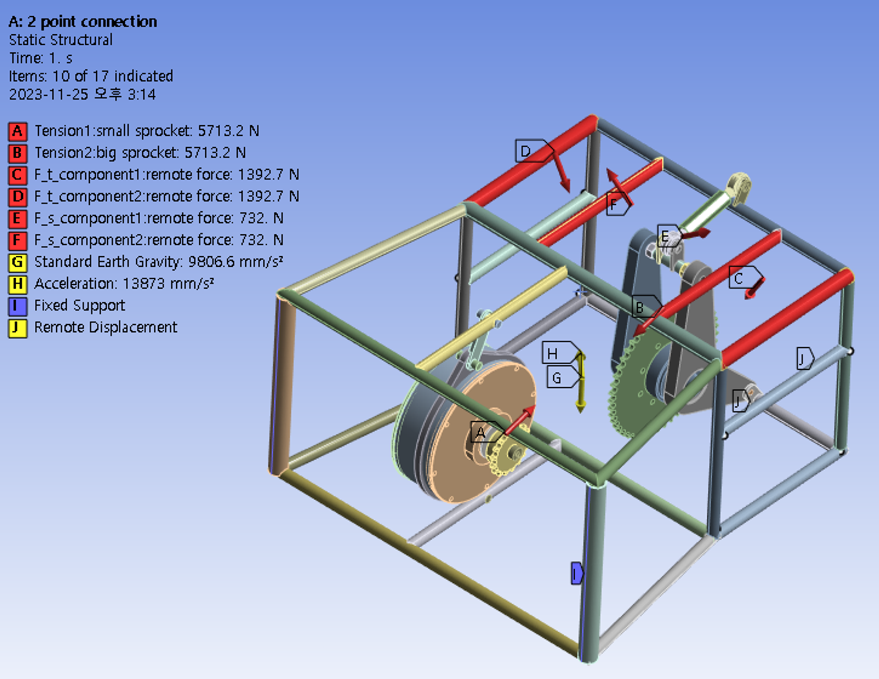
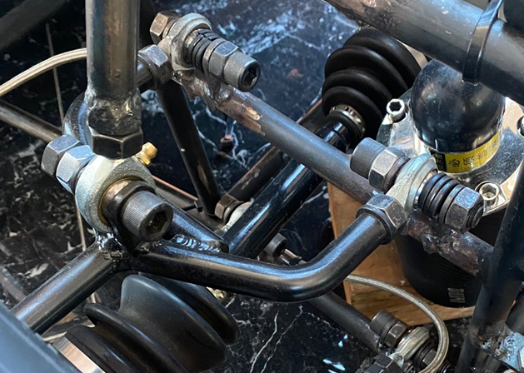
▣ Problem analysis
Analysis condition
Considered force
Tension on the chain sprockets
Influence of gravity & acceleration
Suspension & main force of upper frame
Boundary condition
Line fixed support (point welding)
Remote displacement (8 point)
(connecting part : arm – frame)
Notes:
And, this page shows the set forces and boundary conditions.
We explained all of the force components in the last presentation, and I’d like to cover the boundary condition in detail.
As frame is welded in some part with the car body, we set the line with fixed support, not all the surface of the vertical frame.
And as you can see in the picture below, the frames are connected with upper and lower arm with bracket. And they move in the vertical direction and can have a z axis rotation.
So, we set those part with remote displacement with translational y component and the z rotational component as free.
We considered all the offsets cos they are connected with brocket.

Slide 5
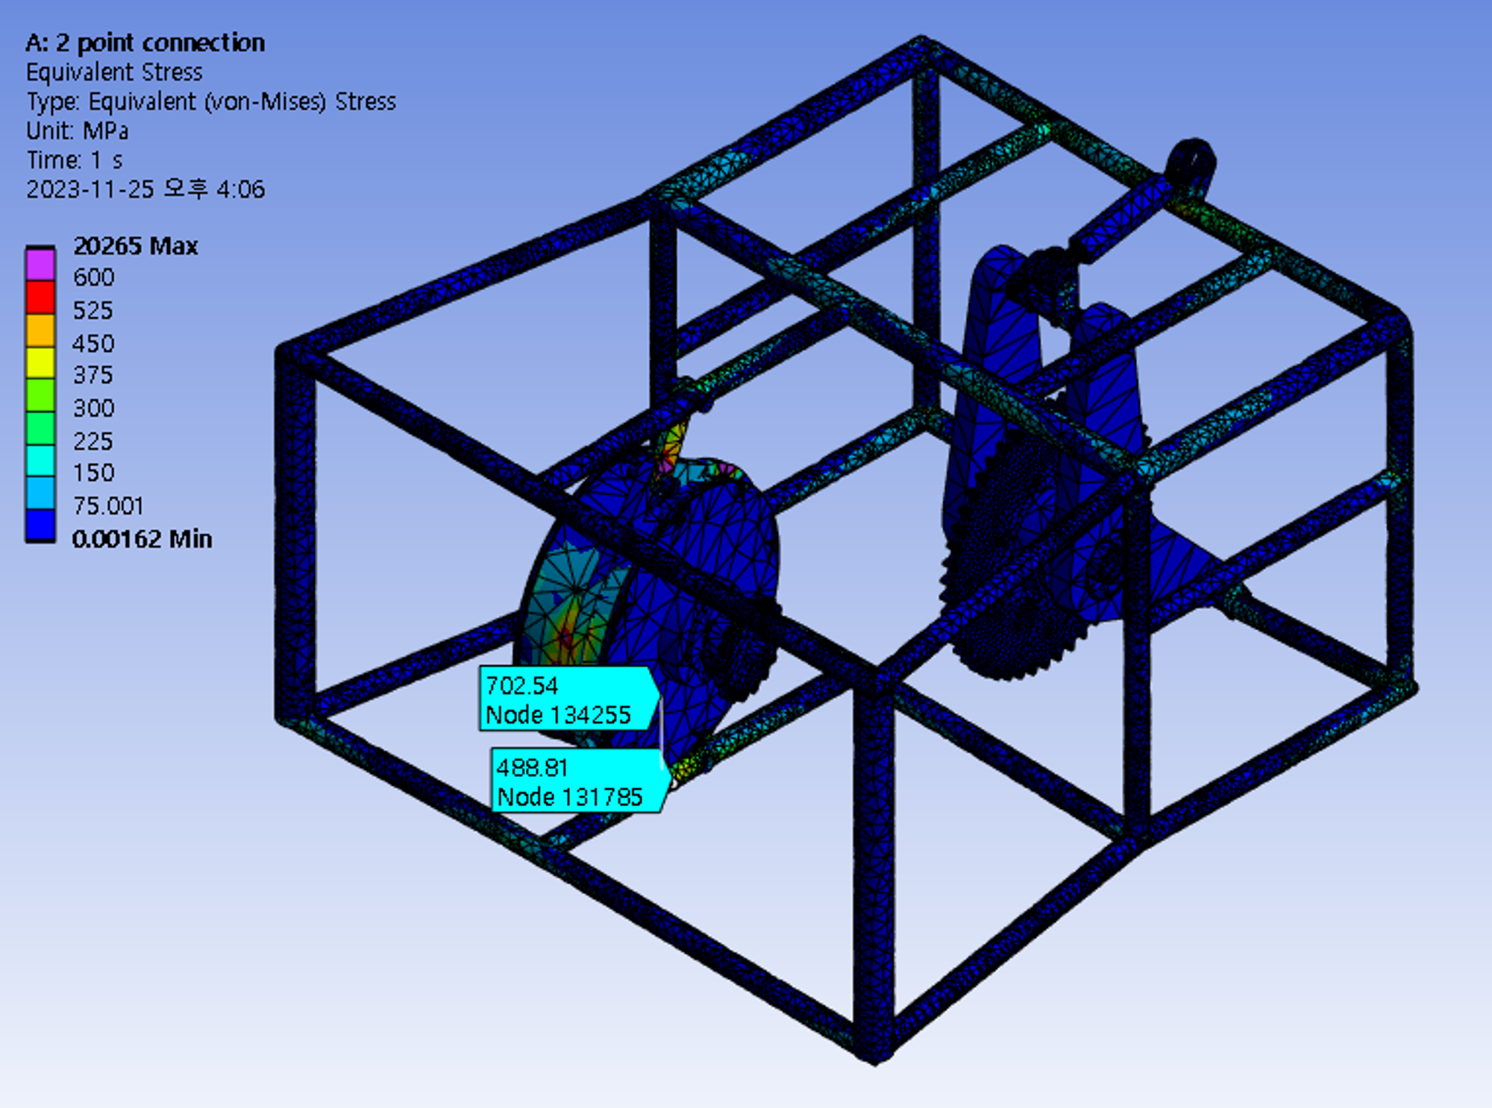
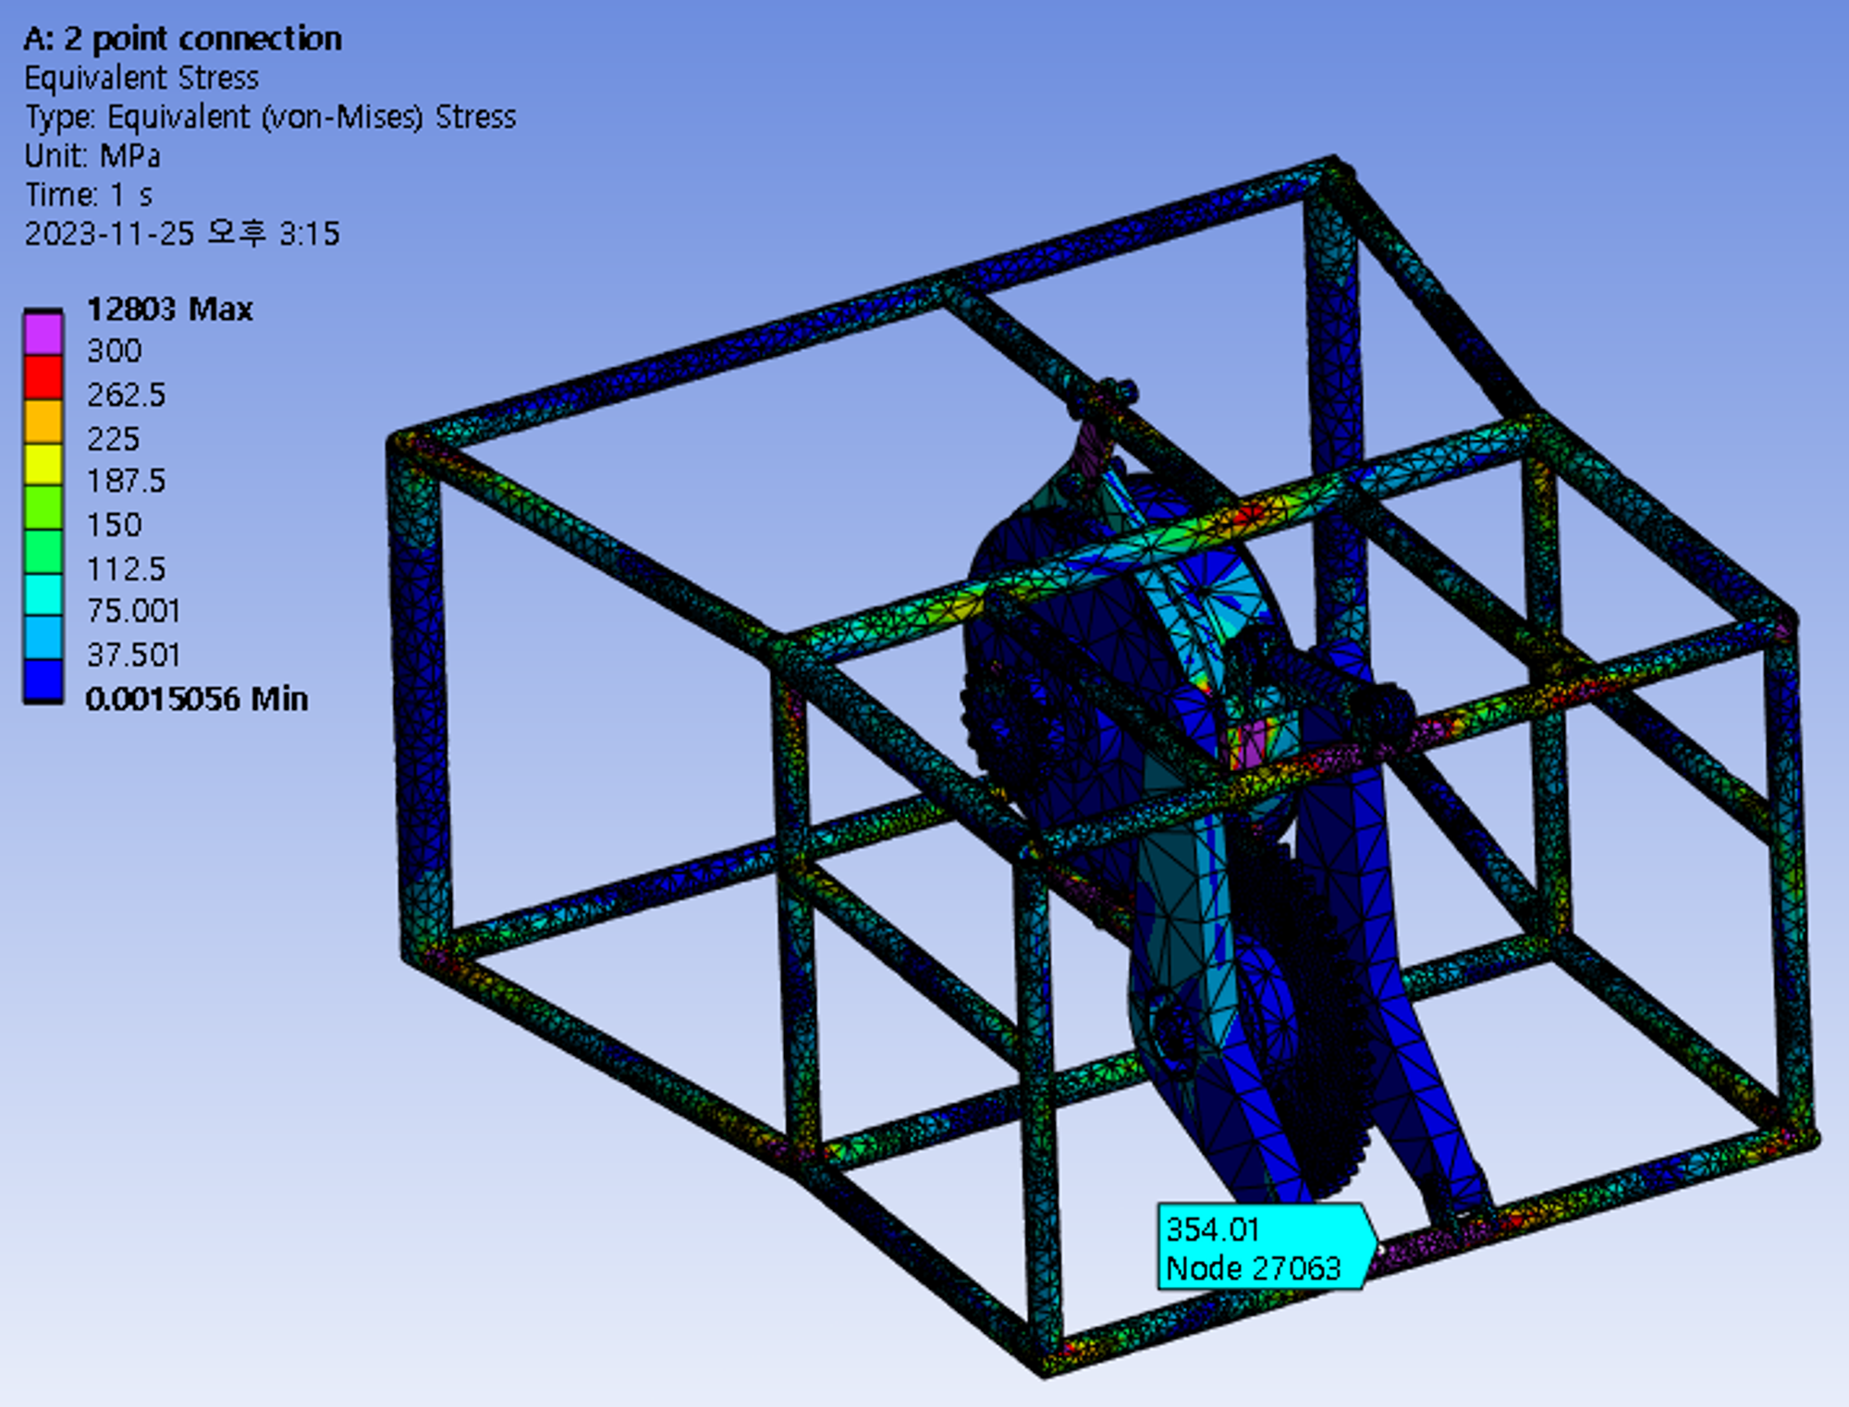
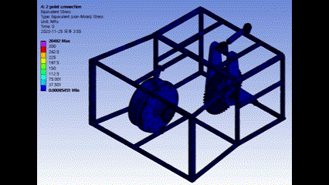
▣ Problem analysis
Analysis result
[Equivalent stress]
[Equivalent stress]
[Result animation : scaled view ]
: Parts suspected of yielding during actual operation
Stress value: $488 \left[MPa\right], 354 [MPa]$
Notes:
This is the analysis result of problem model.
The frames that I marked with red box are the part suspected of yielding during actual operation.
As you can see in the results, stress values around those parts are about in range of 350 – 500 MPa.
We confirmed that when we applied the maximum stress considering many environmental factors, the suspected part reached yielding state.

Slide 6
▣ Developing process
Problems occurred in the two point model
Horizontal rotation of motor due to tension
Displacement of rear part due to tension
Probability of material yield
Development plan
Development plans
Need one more point contact of the motor case
Need more frame considering the displacement of
rear part
[Problem model : 2 point contact]
Notes:
As an developed model to prevent chain loosening and material yielding, we planned to add one more contact to the motor case and add more frames in the below part.
Accordingly, we thought that it would be possible to prevent material yielding by adding some frames in the body.
And we thought that it can be also possible to prevent horizontal rotation of the motor case by adding one more point contact.

Slide 7
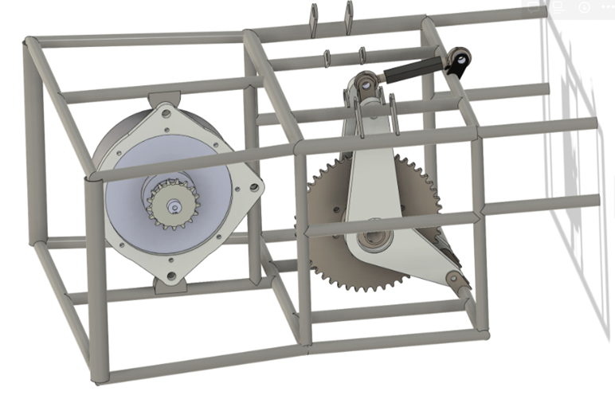
▣ Developing process
Developed model
[Problem model]
[Developed model]
Notes:
And the developed model is specified in the right figure.
As you can see, two frames are added in the below part of the body, and one more point contact are added in the motor case.
And the following results are specified in the next page.

Slide 8
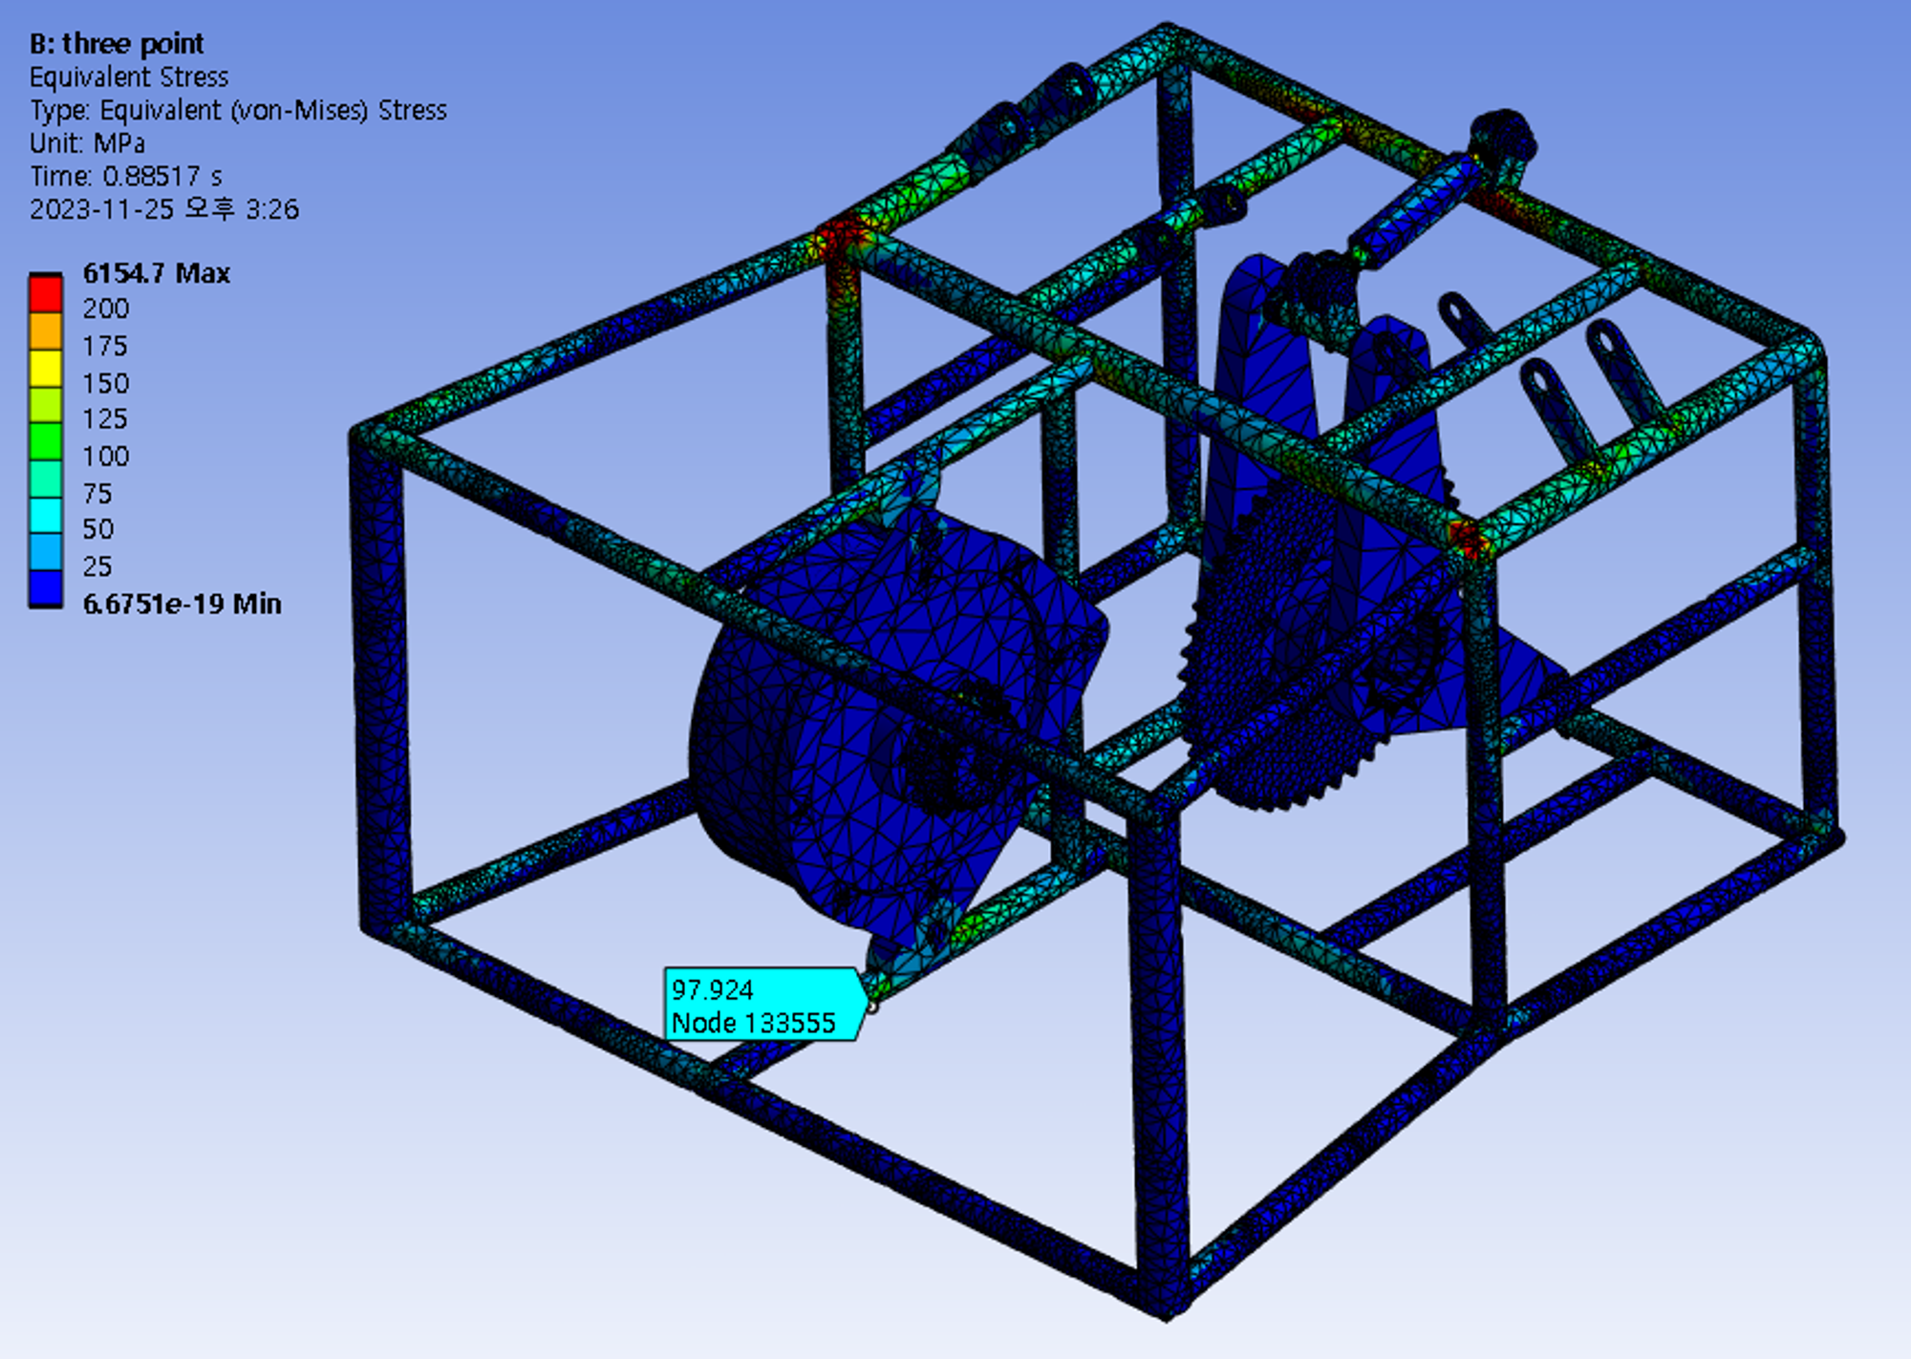
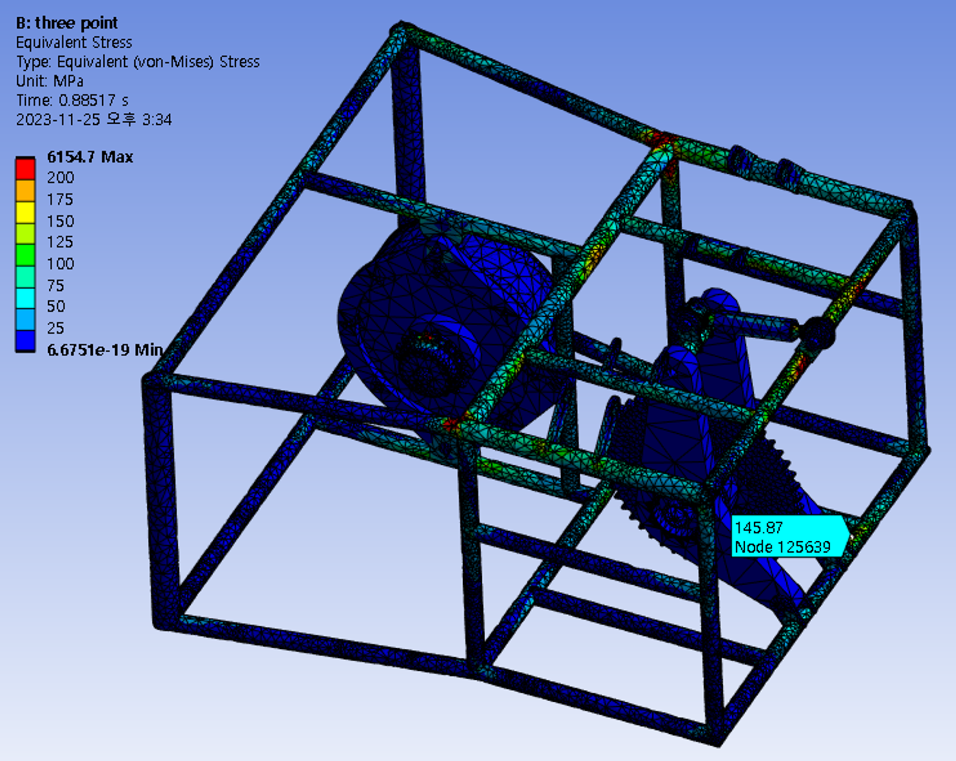
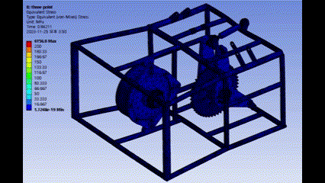
▣ Developing process
Analysis result
[Equivalent stress]
[Equivalent stress]
[Result animation : scaled view ]
Stress value: $97 \left[MPa\right], 145 [MPa]$
Notes:
These figures are the analysis results of three point model. As I mentioned earlier, one more contact for motor case and the two frames are added.
As can be seen in the results of the developed model, it can be seen that the stress, which was a problem at the yield area of ​​the main material, has decreased.
The animation result is just a scaled view.
Later, we plan to find exact solutions by setting boundary conditions and connection conditions those are closer to reality.

Slide 9
▣ Next plan
14th week plan
Fatigue analysis (life & safety factor)
Apply boundary condition & connection those are closer to reality
Notes:
In week 14, we plan to conduct fatigue analysis.
Um, we plan to determine fatigue correction coefficients and analyze the effect of sprocket fatigue due to chain tension.

Slide 10
Thank you

